Slide 1
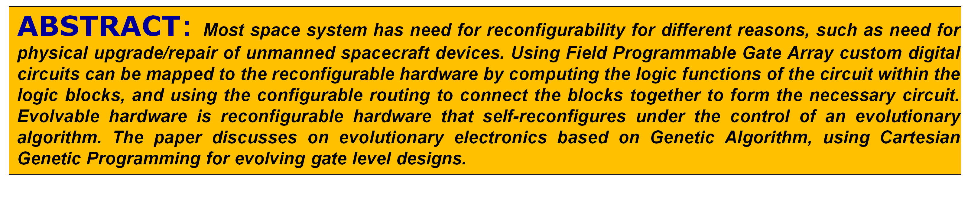
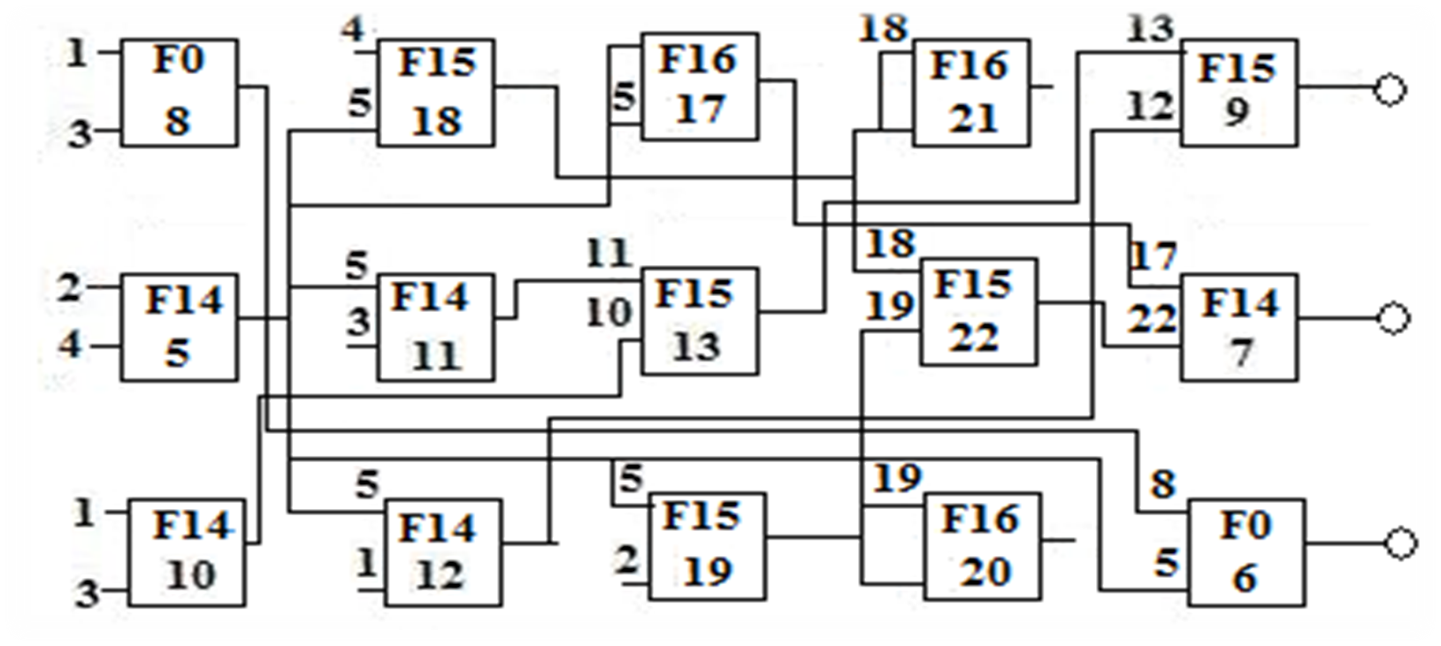
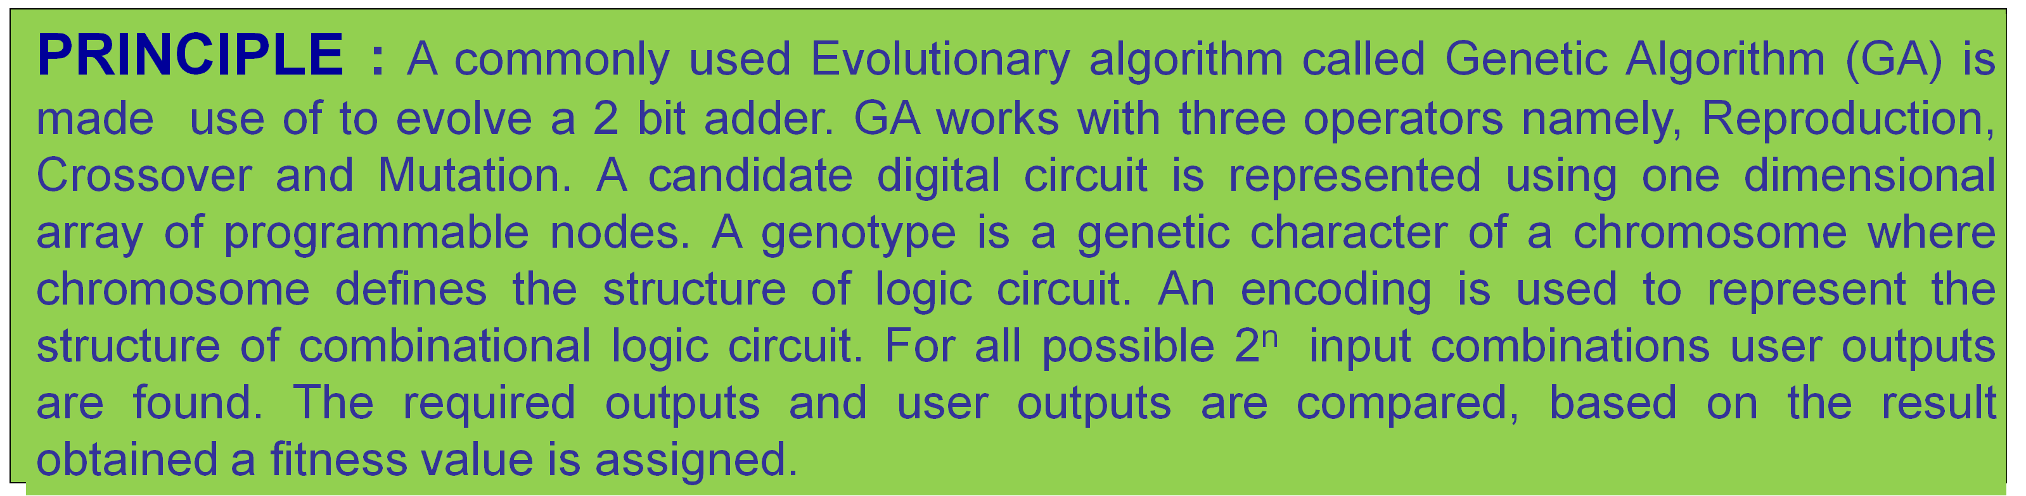

A Novel Approach to evolve 2 bit adder
*Dattprasad B. Vernekar, **Gayatri. Malhotra, *Vanessa Colaco
*Department of Electronics of Telecommunication, Goa Engineering College, Goa - 403401, *Control System Group, ISAC Bangalore – 560017 dattprasad@gmail.com, gayatri@isac.gov.in, vanessa@gec.ac.in
Input Output
Function | Function No | Logic Function
F0 | 0 | XOR
F1 | 14 | AND
F2 | 15 | OR
F3 | 16 | NOT
F={F₀, F₁, F₂, F₃}; n_{c}=5; n_{r}=3; n_{i}=6; n_{o}=3; n_{n}=2; n_{f}=4. Genotype: 1, 3, 0; 4, 5, 15; 5, 5, 16; 18, 18, 16;13, 12, 15; 2, 4, 14; 5, 3, 14; 11, 10, 15; 19, 18, 15; 17, 22, 14; 1, 3, 14; 5, 1, 14; 5, 2, 15; 19, 19, 16; 8, 5, 0; 9; 7; 6.
Last three integer determine output
2 bit adder configuration using Cartesian Genetic programming
Analogy of Biology and GA : Primary Inputs to 2 bit adder : Reference Table :
Working Principle of GA:
Start
Initial Population
First Generation
Evaluate Fitness
Condition Met
If Yes, terminate, Else
Proceed
7. Genetic Operators
8. Next Generation
9. Go to step 4
Biological terms | Genetic Algorithm
Chromosome | String | Divided into genes
Gene | Character | Code for changing character
Allele | Feature value | Possible gene for a property
Locus | String position | Position for a gene on chromosome
Genotype | Structure | Combination of gene
Phenotype | Alternative solution | Develops from genotype
Input cases | MSB | LSB
1 | 0 | 0
2 | 0 | 1
3 | 1 | 0
4 | 1 | 1
Input₁ Input₂ Output
Cartesian Genetic Programming:
Parameters : (Input₁,…., Input, Function)
Function: F[F₁,…., F_{N}]
Rows, Columns, Inputs, Outputs, Inputs to each function, Number of Functions
Every node has third gene as Function
Inputs to the first column forms the primary input to adder,
Second and higher column gets input from previous column.
For the above 2 bit configuration as each gene is coded by 5 bits, the length of
genotype, phenotype is 225 bits.
 | a(1) | a(0) | b(1) | b(0) | o(2) | o(1) | o(0)
0 | 0 | 0 | 0 | 0 | 0 | 0 | 0
1 | 0 | 0 | 0 | 1 | 0 | 0 | 1
2 | 0 | 0 | 1 | 0 | 0 | 1 | 0
3 | 0 | 0 | 1 | 1 | 0 | 1 | 1
4 | 0 | 1 | 0 | 0 | 0 | 0 | 1
5 | 0 | 1 | 0 | 1 | 0 | 1 | 0
6 | 0 | 1 | 1 | 0 | 0 | 1 | 1
7 | 0 | 1 | 1 | 1 | 1 | 0 | 0
8 | 1 | 0 | 0 | 0 | 0 | 1 | 0
9 | 1 | 0 | 0 | 1 | 0 | 1 | 1
10 | 1 | 0 | 1 | 0 | 1 | 0 | 0
11 | 1 | 0 | 1 | 1 | 1 | 0 | 1
12 | 1 | 1 | 0 | 0 | 0 | 1 | 1
13 | 1 | 1 | 0 | 1 | 1 | 0 | 0
14 | 1 | 1 | 1 | 0 | 1 | 0 | 1
15 | 1 | 1 | 1 | 1 | 1 | 1 | 0
2 bit adder
Primary inputs : 1, 2, 3, 4
Logic Functions : 0, 14, 15, 16
Evolved Outputs : 7, 6, 9
Represent individual gene by bit string of 5 bits each :
Gene Binary code Gene Binary code Before Crossover:
0 | 0 | 0 | 0 | 0 | 0 | 16 | 1 | 0 | 0 | 0 | 0
1 | 0 | 0 | 0 | 0 | 1 | 17 | 1 | 0 | 0 | 0 | 1
2 | 0 | 0 | 0 | 1 | 0 | 18 | 1 | 0 | 0 | 1 | 0
3 | 0 | 0 | 0 | 1 | 1 | 19 | 1 | 0 | 0 | 1 | 1
4 | 0 | 0 | 1 | 0 | 0 | 20 | 1 | 0 | 1 | 0 | 0
5 | 0 | 0 | 1 | 0 | 1 | 21 | 1 | 0 | 1 | 0 | 1
6 | 0 | 0 | 1 | 1 | 0 | 22 | 1 | 0 | 1 | 1 | 0
7 | 0 | 0 | 1 | 1 | 1 | 23 | 1 | 0 | 1 | 1 | 1
8 | 0 | 1 | 0 | 0 | 0 | 24 | 1 | 1 | 0 | 0 | 0
9 | 0 | 1 | 0 | 0 | 1 | 25 | 1 | 1 | 0 | 0 | 1
10 | 0 | 1 | 0 | 1 | 0 | 26 | 1 | 1 | 0 | 1 | 0
11 | 0 | 1 | 0 | 1 | 1 | 27 | 1 | 1 | 0 | 1 | 1
12 | 0 | 1 | 1 | 0 | 0 | 28 | 1 | 1 | 1 | 0 | 0
13 | 0 | 1 | 1 | 0 | 1 | 29 | 1 | 1 | 1 | 0 | 1
14 | 0 | 1 | 1 | 1 | 0 | 30 | 1 | 1 | 1 | 1 | 0
15 | 0 | 1 | 1 | 1 | 1 | 31 | 1 | 1 | 1 | 1 | 1
Bit string 1 Bit string 2
Reconfigurable
Hardware
(Virtex E)
Applications:
Combinational circuits can be evolved using Evolvable Hardware
techniques, increasing the functionality of deployed hardware
systems for space missions.
Use of multichip system reduces the time required to redesign the
system every time.
The proposed evolvable unit can be redesigned according to the
needs of given application.
Evolution Strategy
( Spartan II)
Reconfiguration
bits
Reconfiguration
bits
0 | 1 | 1 | 1
0 | 1 | 0 | 0
Fitness value
Fitness Value
FPGA based Run Time Configuration System
FPGA based EHW development and Evolution unit s et-up can be applied for future space applications
0 | 1 | 1 | 0
0 | 1 | 0 | 1
Bit string 1 Bit string 2
CONCLUSION : For space vehicle after launch, new designs involving combinational circuit like 2 bit adder can be evolved on orbit using Genetic Algorithm. Once a 2 bit adder is evolved using genetic Algorithm, other combinational logic, sequential logic circuits will be the next step to evolve.
After Crossover
Mutation
0 | 1 | 1 | 1 | 0 | 1 | 0 | 1
CONTACT
Vernekar Dattprasad B. Department of Electronics & Telecommunication , College of Engineering, Goa, India 403 401
Email : dattprasad@gmail.com Phone : +91 9823244265
Primary Inputs
User Outputs
Functions
Intermediate Input Output
Unused Integer
Coding a gene by a binary string
0 | 1 | 1 | 0 | 0 | 1 | 0 | 1

